Slide 1

Joint Policing Committee – Tipperary Division
17th May 2024
Chief Superintendent Aileen Magner

Slide 2
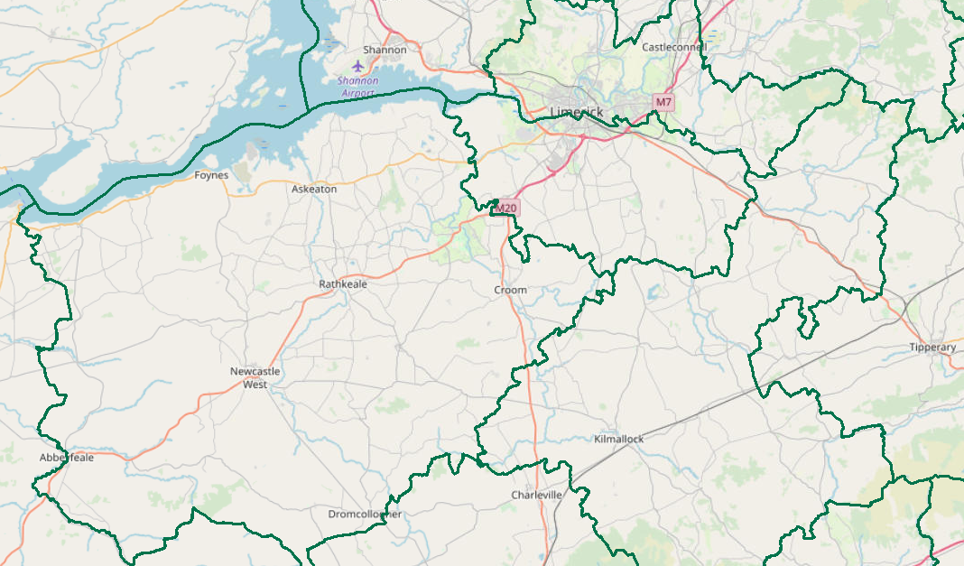
JPC Objectives
  Provide a brief statistical overview of current position as of 03/05/2024:
    Domestic Abuse Incidents (1st Jan – 5th May, 2024 vs. 2023)
    Property Crime at a Divisional Level (broken down by District) (1st Jan – 30th April, 2024 vs. 2023)
      Additional attention afforded to Burglary
    Crime Against the Person at a Divisional Level (broken down by District) (1st Jan – 30th April, 2024 vs. 2023)
      Additional attention afforded to Assault.
    Proactive Policing Measure (1st Jan – 30th April, 2024 vs. 2023)
      Includes Possession of Drugs, Sale of Drugs, and Offensive Weapons
    Traffic (1st Jan – 30th April, 2024 vs. 2023)
      Fatalities/Serious Injuries figures YTD
      Drink and Drug Driving Offences
      LifeSaver Offences (note: 1st Jan – 31st Mar, 2024 vs. 2023)
  All information is based upon operational data from the PULSE System as was available on the 03/05/2024 and is liable to change. Crime Counting rules are applied, unless otherwise stated. Incident counts are based on date reported.

Slide 3
Domestic Abuse Incidents
includes
Breach of Barring Order
Breach of Protection Order
Breach of Safety Order
Domestic Dispute – No Offence Identified
Any incident with Domestic M.O.
YTD (1st Jan – 5th May 2024)
the Division is
-3%
Based upon operational data from the PULSE System as was available on the 07/05/2024 and is liable to change. Incident counts are based on date reported.

Slide 4
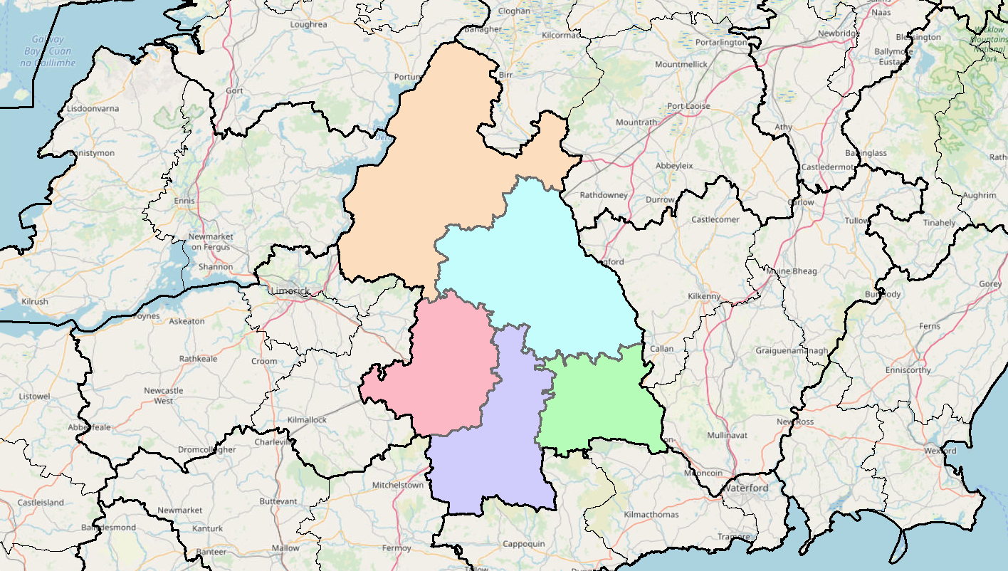
Property Crime includes:
All Robbery
All Burglary
And various Theft Offences
YTD the Division is +24%
(509 to 631)
-3%%
(118 to 115)
Nenagh
+65%
(77 to 127)
Thurles
+69%
(62 to 105)
Tipp Town
+12%
(182 to 203)
+16%
(70 to 81)
Cahir
Detections are -11% YTD (254 to 226)

Slide 5
Non Aggravated Burglary
YTD the Division is +69% YTD
(74 to 125 )
+127%
(11 to 25)
Residential Burglary is +83% YTD
Non Residential Burglary is +30% YTD
+91%
(11 to 21)
+76%
(21 to 37)
+6%
(18 to 19)
+77%
(13 to 23)
Detections are +57% YTD (21 to 33)

Slide 6
Crimes Against the Person includes
Murder
Murder Threat
All Assaults
Harassment
Child Abandonment
Neglect or Abuse.
YTD the Division is -9%
(198 to 181)
-2%
(42 to 41)
-38%
(60 to 37)
-16%
(19 to 16)
+17%
(52 to 61)
+4%
(25 to 26)
Detections are -57%YTD (186 to 80)

Slide 7
Assaults includes:
Assaults Causing Harm
Minor Assaults
YTD the Division is -9%
(152 to 138)
-26%
(35 to 26)
Assaults Causing Harm: -40% YTD (55 to 33)
Minor Assaults : +8% YTD (97 to 105)
-42%
(50 to 29)
-7%
(15 to 14)
+38%
(34 to 47)
+22%
(18 to 22)
Detections are -64% YTD (135 to 49)

Slide 8
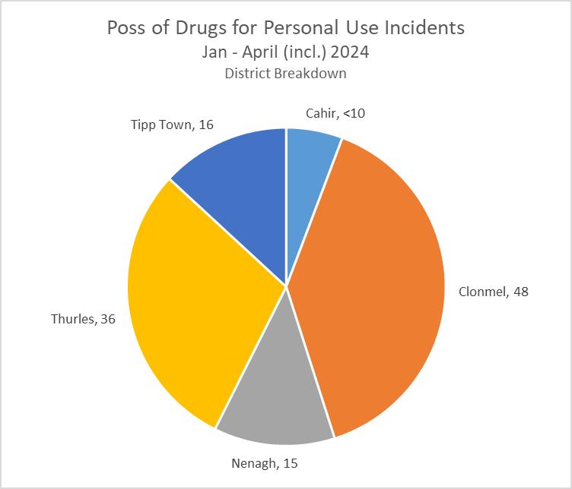
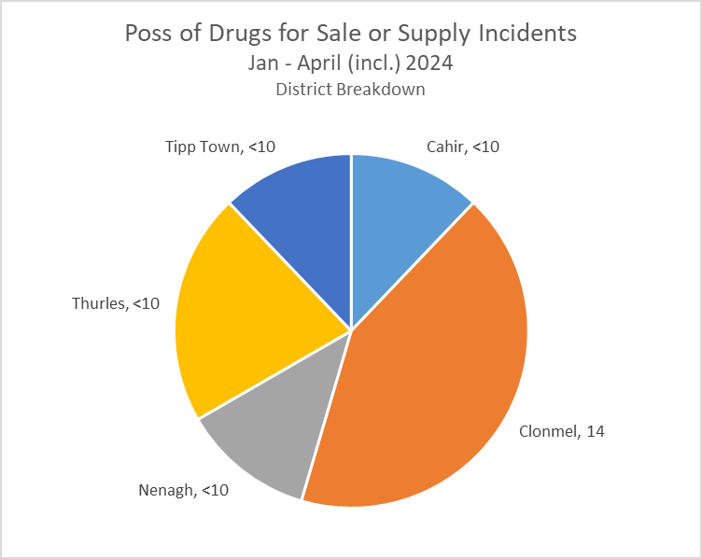
Proactive Policing Measures
Possession of Firearms/Offensive Weapons
-33% YTD
(33 to 22)
*Crime Counting Rules not applied
Possession of Drugs for Personal Use
down 3% YTD
(126 to 122)
Possession of Drugs for Sale/Supply
No change 0% YTD
(33 to 33)

Slide 9



Traffic (YTD 2023 vs. 2024)
Fatal Collisions are 0% change
Serious Injury Collisions are down 53%
There have been 775 MIT Checkpoints conducted in the Division
Driving Vehicle over legal alcohol limit: down 11% (71 to 63)
Driving Vehicle under the influence of Drugs: up 69% (13 to 22)
Our most recent data regarding LifeSaver Offences shows the following Jan to Mar Trends
Mobile Phone
-2%
(151 to 148)
Seatbelt
-28%
(86 to 62)
Speed (Intercept & Non-Intercept)
-17%
(3,808 to 3,142)
Based upon operational data from the PULSE System as was available on the 03/05/2024 and is liable to change. Incident counts are based on date reported.

Slide 10


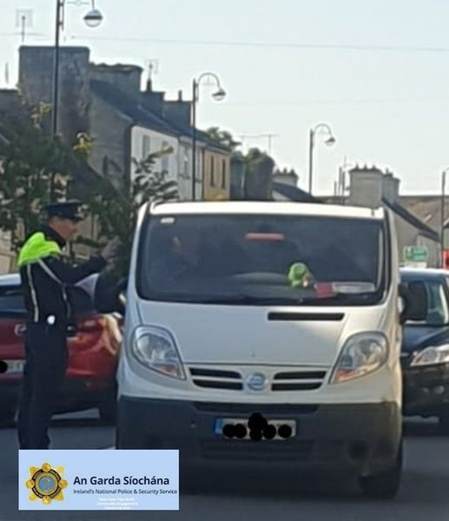
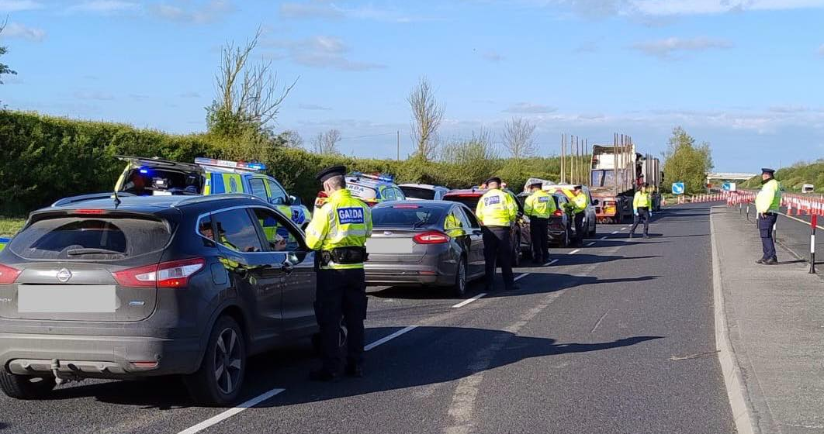
SAFER ROADS Operation
Garda Garret Ryan spoke with several motorists in Borrisokane, Co. Tipperary. While the majority of drivers spoken to this morning had everything in order on their vehicles, several offences were detected with fixed-charged penalty notices issued
Clare Tipperary Roads Policing Unit carried out a multi agency checkpoint on the M8 Cashel. Two uninsured drivers were taken off the road. Gardai supported Three other State agencies and their enforcement needs at the checkpoint, including RSA, HSA and Revenue.

Slide 11
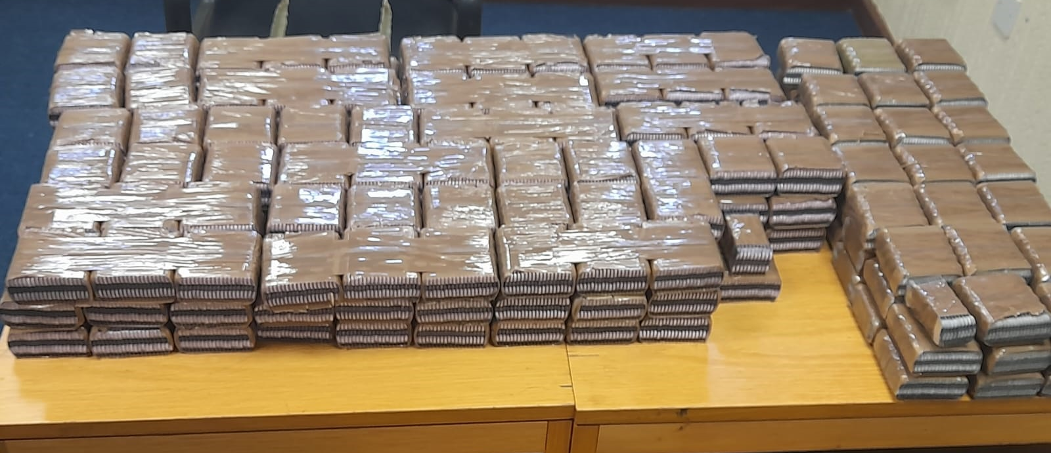
Drugs
An intelligence-led multi agency operation was conducted in the Tipperary Town area. The Operation involved Revenue’s Customs Service, the Garda National Drugs and Organised Crime Bureau (GNDOCB) and the Tipperary Divisional Drugs Unit. Revenue officers seized approximately €62,500 of suspected Alprazolam and Clonazepam tablets with an estimated street value of €125,000.

Slide 12
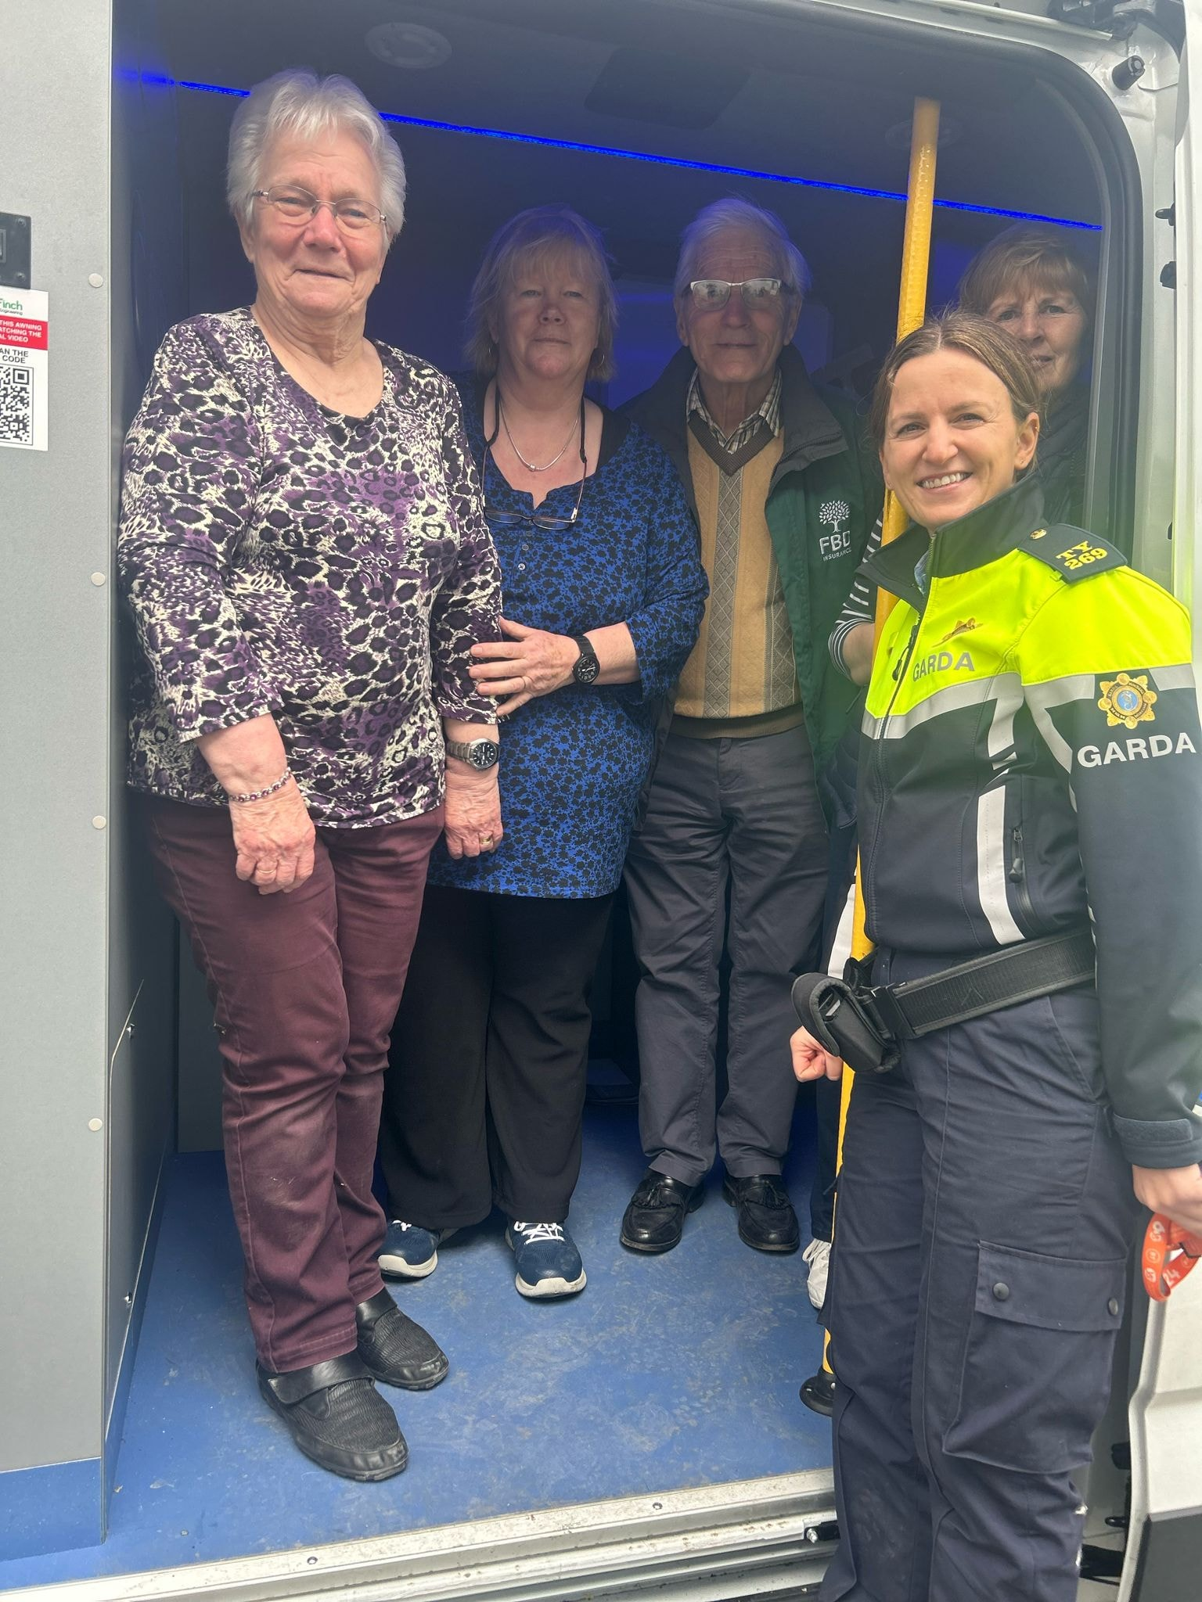
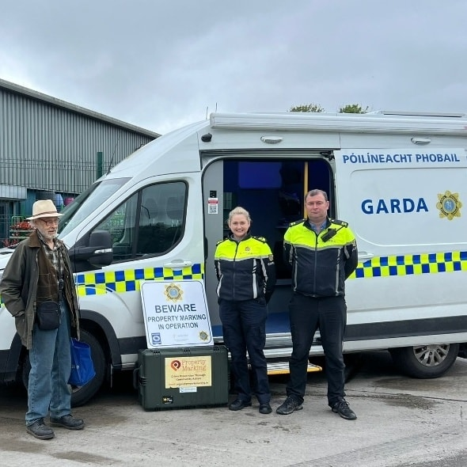

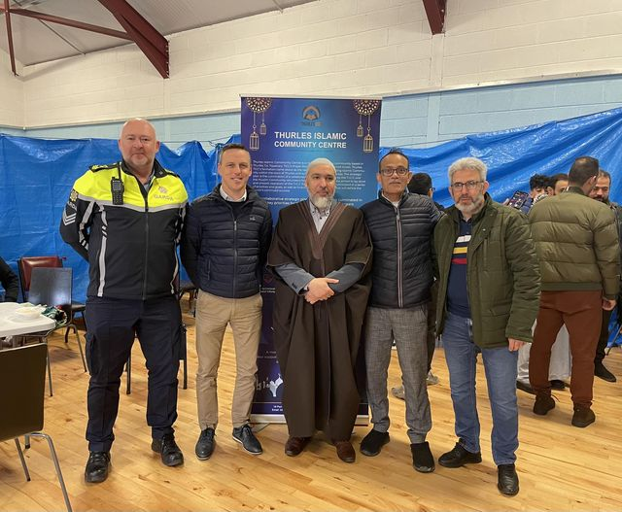
Community Engagement
Garda Maureen Finnerty and Garda Tony Brehon took our Community Engagement Van to Lorrha North Tipperary today to meet with locals
Our Community Gardaí met with Muslim Community across Tipperary county
Property Marking event at McKeogh’s Home, Garden,
DIY Build, Ballina, Co.Tipperary

Slide 13
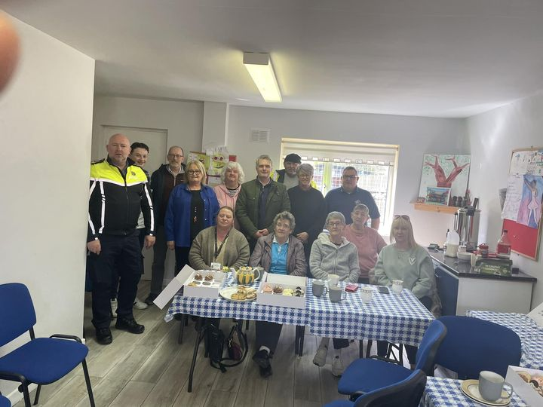
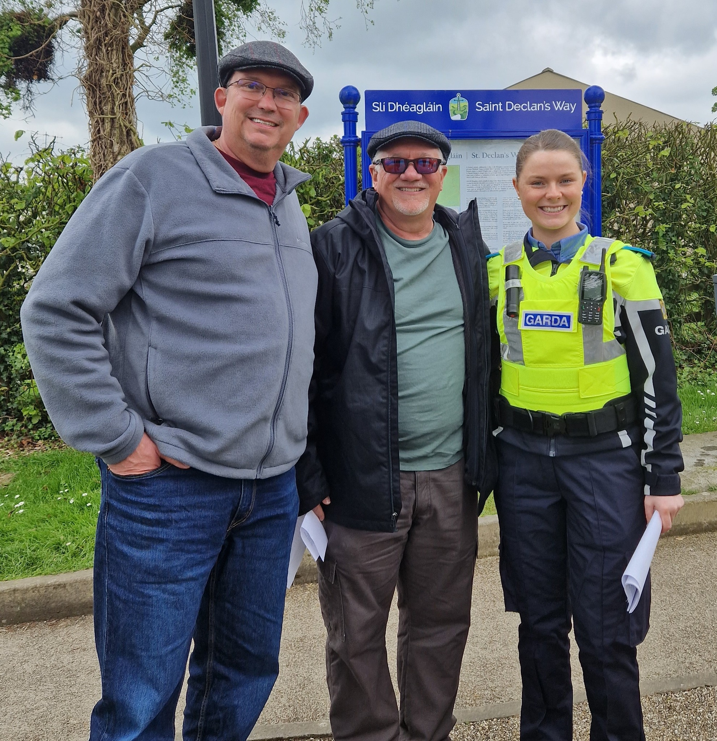
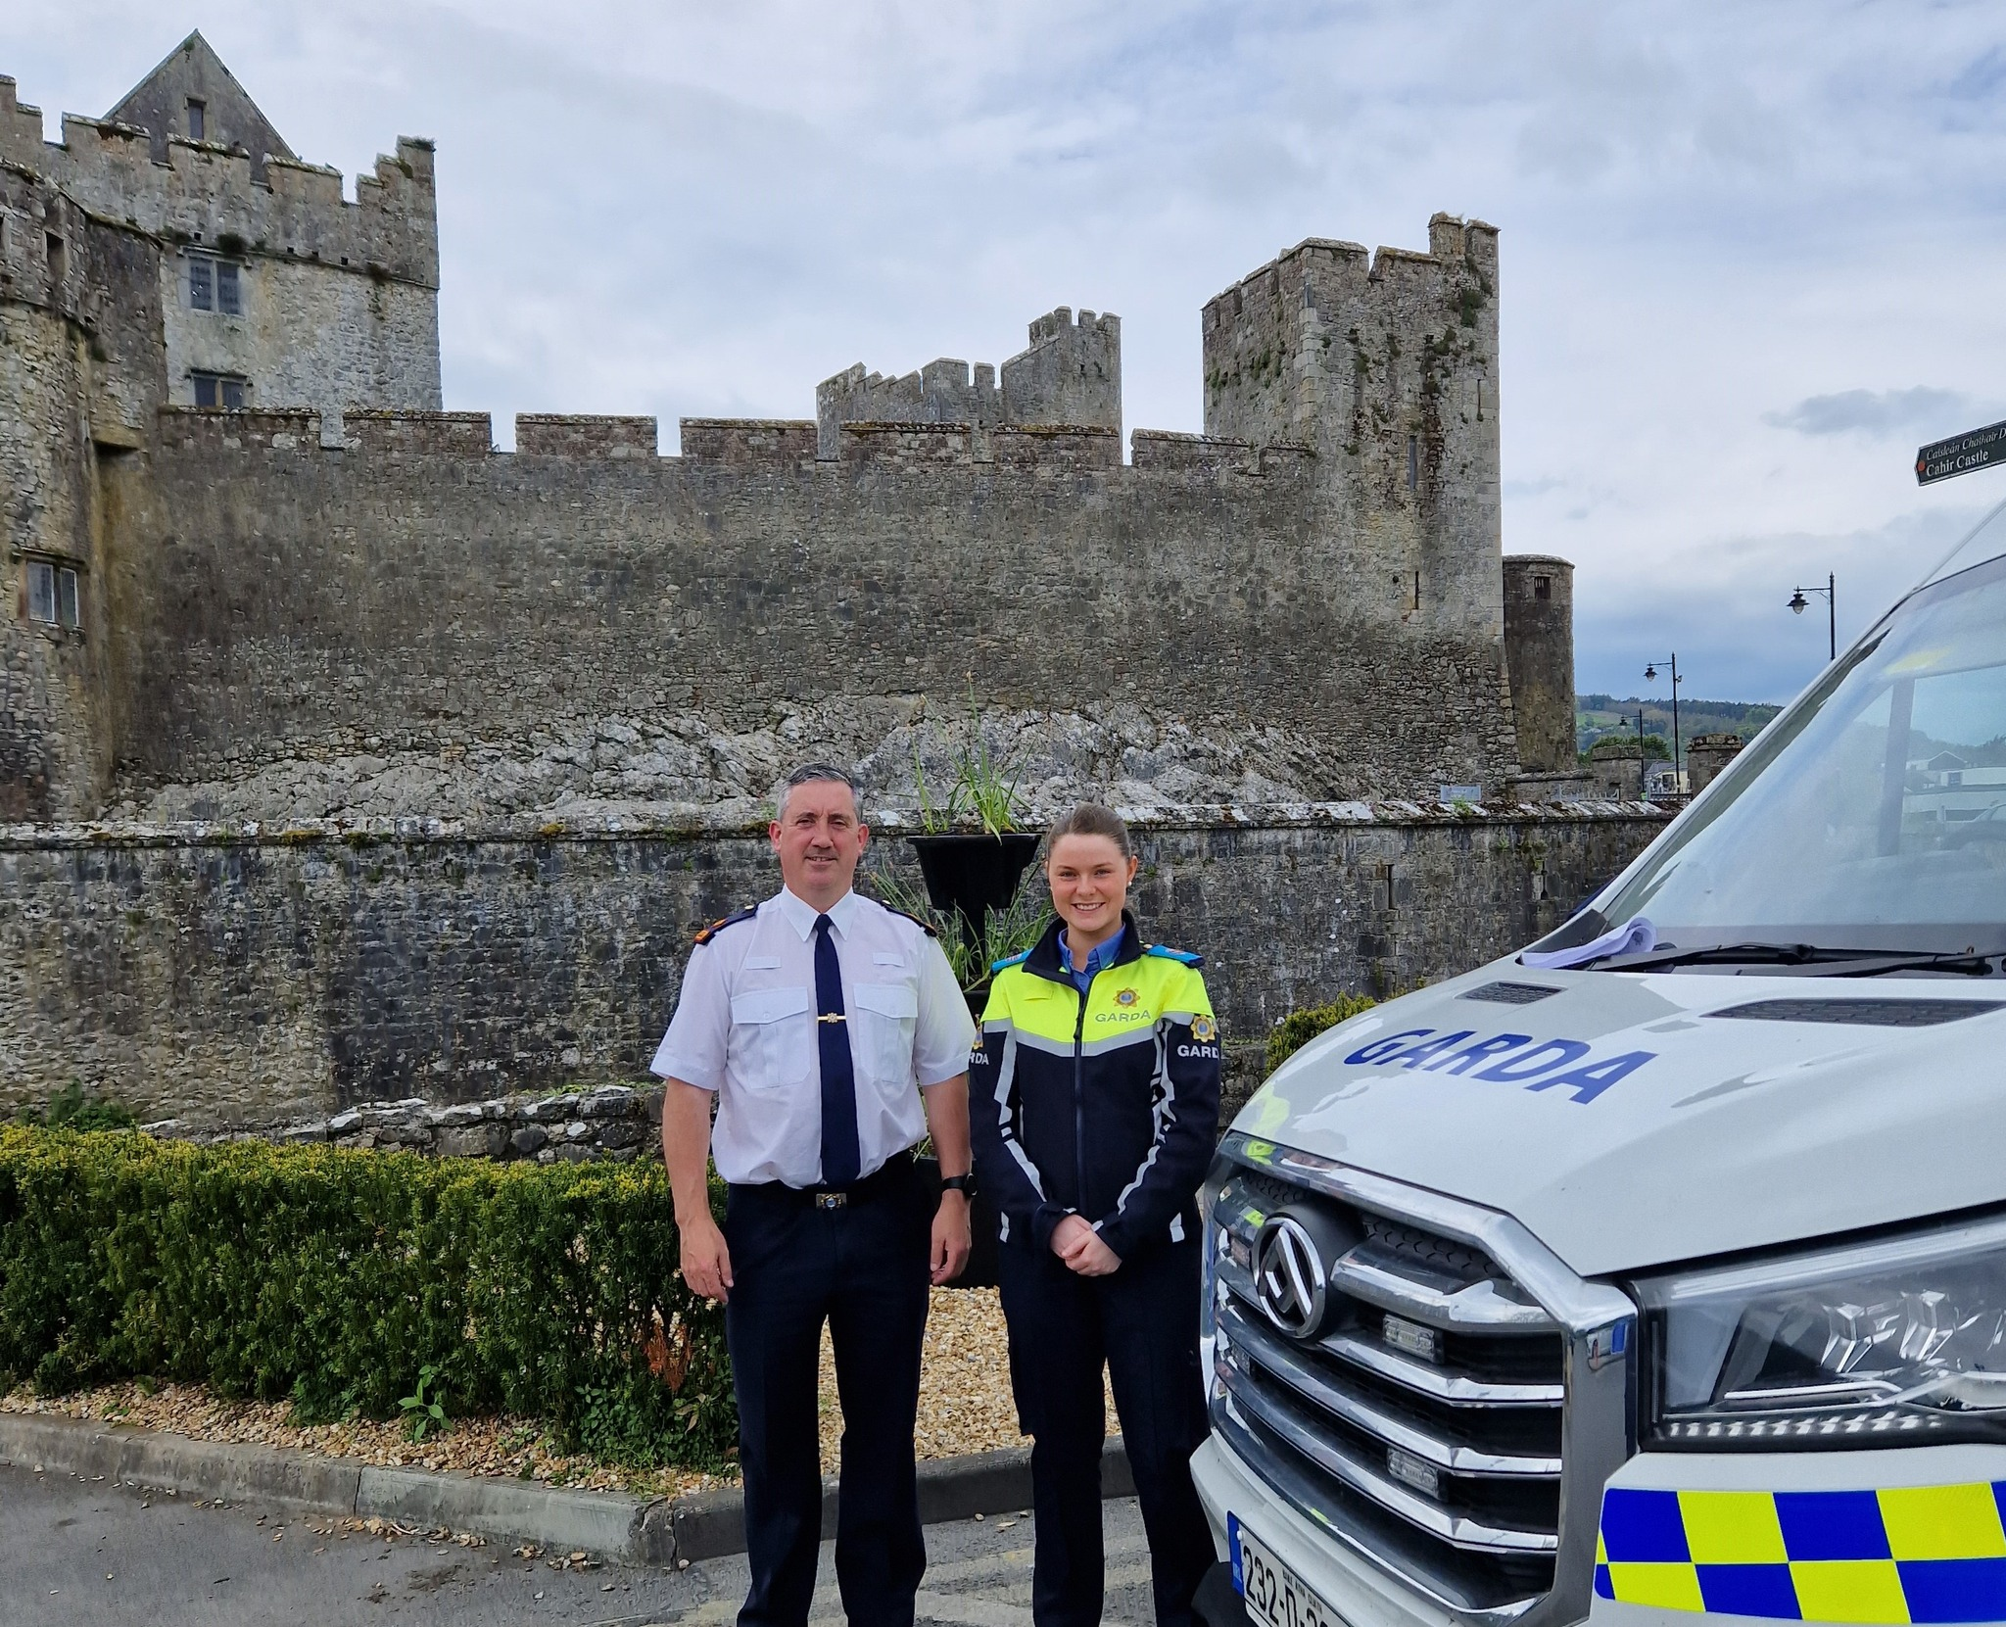
Community Engagement
Community Garda Moloney Met with Community Resident Associations
Community Gardaí took a visit to the Rock of Cashel and Cahir Castle to talk to tourists & share safety information on crime prevention

Slide 14

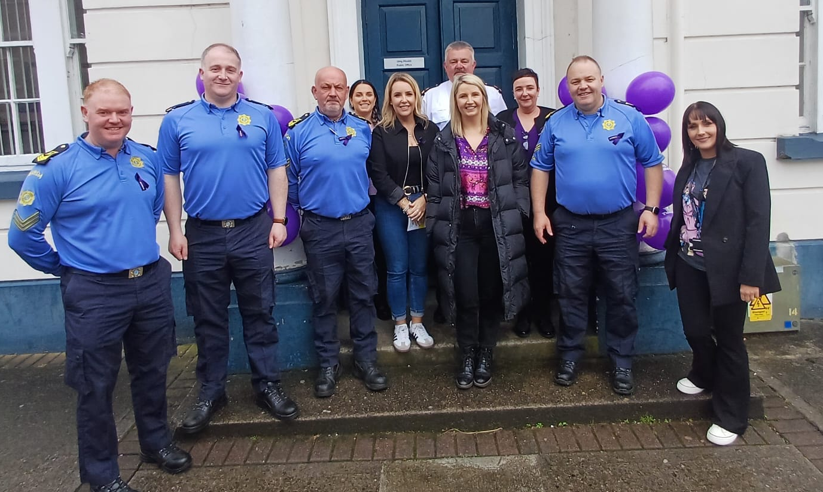
Go Purple Day
Go Purple Day is a joint initiative led by An Garda Síochána and various domestic abuse services across Ireland. We aim to raise awareness about supports and services available to people who experience domestic abuse, and to advocate together for a society with zero tolerance of domestic abuse.
The colour purple symbolises love, strength, dignity and independence - qualities of a compassionate community committed to eradicating abuse and violence.
A number of event took place in Garda Stations across Co. Tipperary

