Slide 1

Tipperary Joint Policing Committee
Clare/Tipperary Division
27th February 2024
Chief Superintendent Aileen Magner

Slide 2
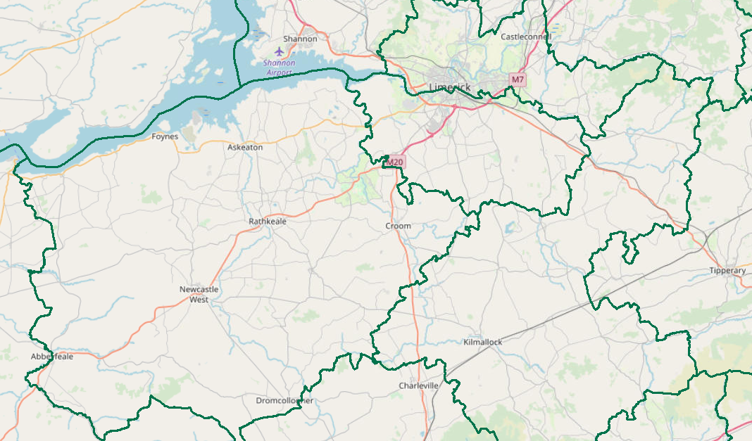
Objectives
  Provide a brief statistical overview of current position as of February 2024:
    Domestic Abuse Incidents
    Property Crime at a Divisional Level (broken down by District)
      Additional attention afforded to Burglary
      Statistics based on Nov, Dec 2022 & Jan 2023 (3 mth period) compared with Nov, Dec 2023 & Jan 2024 (3 mth period)
    Crime Against the Person at a Divisional Level (broken down by District)
      Additional attention afforded to Assault.
      Statistics based on Nov, Dec 2022 & Jan 2023 (3 mth period) compared with Nov, Dec 2023 & Jan 2024 (3 mth period)
    Proactive Policing Measure
      Includes Possession of Drugs, Sale of Drugs, and Offensive Weapons
      Statistics based on Nov, Dec 2022 & Jan 2023 (3 mth period) compared with Nov, Dec 2023 & Jan 2024 (3 mth period)
    Traffic
      Fatalities/Serious Injuries figures
      Drink and Drug Driving Offences
      LifeSaver Offences
      With the exception of LifeSaver Offences Statistics based on Nov, Dec 2022 & Jan 2023 (3 mth period) compared with Nov, Dec 2023 & Jan 2024 (3 mth period)
  All information is based upon operational data from the PULSE System as was available on the 20/02/2024 and is liable to change. Crime Counting rules are applied, unless otherwise stated. Incident counts are based on date reported.

Slide 3
Domestic Abuse Incidents
includes
Breach of Barring Order
Breach of Protection Order
Breach of Safety Order
Domestic Dispute – No Offence Identified
Any incident with Domestic M.O.
YTD (Week 1 to Week 7)
the Division is
-19%
Based upon operational data from the PULSE System as was available on the 19/02/2024 and is liable to change. Incident counts are based on date reported.

Slide 4
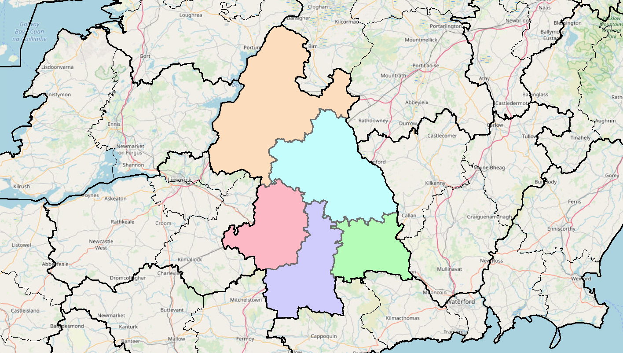
Property Crime includes:
All Robbery
All Burglary
And various Theft Offences
Tipperary Division is +22%
(370 to 450)
Nenagh
+10%
(81 to 89)
Statistics are based on Nov, Dec 2022 & Jan 2023 (3 mth period) compared with Nov, Dec 2023 & Jan 2024 (3 mth period)
Thurles
+32%
(69 to 91)
Tipp Town
+19%
(62 to 74)
Clonmel
+2%
(126 to 129)
Cahir
+109%
(32 to 67)
Detections are -16% (204 to 172)

Slide 5
Non Aggravated Burglary
Tipperary Division is +65%
(52 to 86)
Nenagh
+50%
(12 to 18)
Statistics are based on Nov, Dec 2022 & Jan 2023 (3 mth period) compared with Nov, Dec 2023 & Jan 2024 (3 mth period)
Thurles
+100%
(10 to 20)
Tipp Town
+54%
(13 to 20)
Clonmel
+30%
(10 to 13)
Cahir
+114%
(figures less than 10)
Detections are -8% (25 to 23)

Slide 6
Crimes Against the Person includes
Murder
Murder Threat
All Assaults
Harassment
Child Abandonment
Neglect or Abuse.
Tipperary Division is -4%
(154 to 148)
Nenagh
+6%
(31 to 33)
Statistics are based on Nov, Dec 2022 & Jan 2023 (3 mth period) compared with Nov, Dec 2023 & Jan 2024 (3 mth period)
Thurles
-32%
(34 to 23)
Tipp Town
-13%
(16 to 14)
Clonmel
+22%
(46 to 56)
Cahir
-19%
(27 to 22)
Detections are -21% (97 to 77)

Slide 7
Assaults includes:
Assaults Causing Harm
Minor Assaults
Tipperary Division is -10%
(119 to 107)
Nenagh
No change
(26 to 26)
Statistics are based on Nov, Dec 2022 & Jan 2023 (3 mth period) compared with Nov, Dec 2023 & Jan 2024 (3 mth period)
Assaults Causing Harm: -38% YTD (53 to 33)
Minor Assaults : +12% YTD (66 to 74)
Thurles
-35%
(26 to 17)
Tipp Town
-10%
(figures less than 10)
Clonmel
+20%
(35 to 42)
Cahir
-41%
(22 to 13)
Detections are -38% (79 to 49)

Slide 8
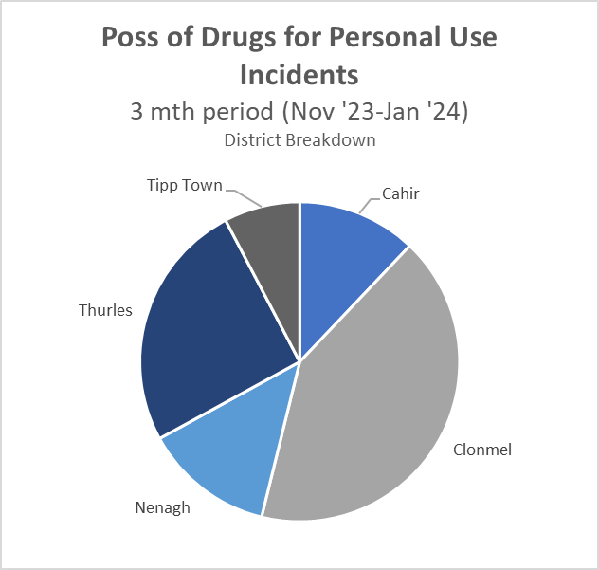
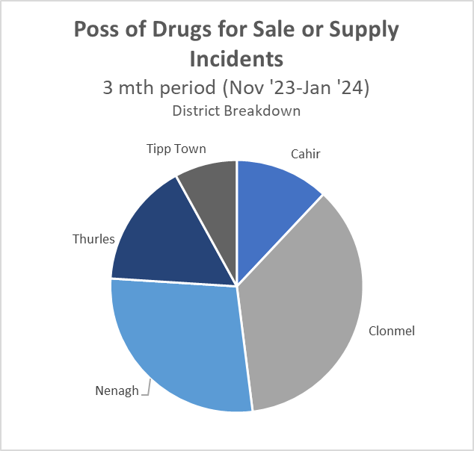
Proactive Policing Measures
Statistics are based on Nov, Dec 2022 & Jan 2023 (3 mth period) compared with Nov, Dec 2023 & Jan 2024 (3 mth period)
Possession of Drugs for Personal Use
Down 1%
(92 to 91)
Possession of Drugs for Sale/Supply
Up 9% YTD
(23 to 25)
Searches in Tipperary side of the Division -2402 in 2023
Possession of a Firearm
No change
(figures less than 10)
Possession of an Offensive Weapons
+100%
(figures less than 10)

Slide 9
Statistics are from 01.01.2023 – 31.12.2023
Domestics/Non-Crime related incidents requiring Garda action in Tipperary during 2023
Domestic Violence incidents in Tipperary in 2023 - 940
TUSLA referrals in Tipperary in 2023 - 1738
Persons detained under the Mental Health Act in Tipperary in 2023 - 293

Slide 10



Traffic
Statistics are based on Nov, Dec 2022 & Jan 2023 (3 mth period) compared with Nov, Dec 2023 & Jan 2024 (3 mth period)
Fatal Collisions: down 100%
Serious Injury Collisions: are down 40% (figures less than 10)
There have been 781 MIT Checkpoints conducted in the Division (up 4%)
Driving Vehicle over legal alcohol limit: down 14% (64 to 55)
Driving Vehicle under the Influence of drugs: down 53% (17 to 8)
Our most recent data regarding LifeSaver Offences shows the following Jan to Dec Trends
Mobile Phone
+6%
(602 to 637)
Seatbelt
-4%
(288 to 276)
Speed (Intercept & Non-Intercept)
+38%
(12,881 to 17,798)
Based upon operational data from the PULSE System as was available on the 20/02/2024 and is liable to change. Incident counts are based on date reported.

Slide 11
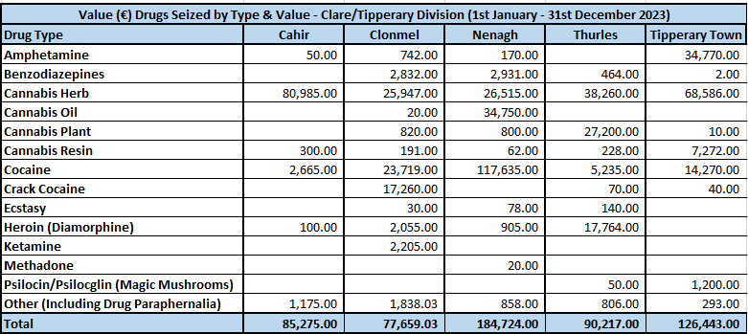
Drugs detections in 2023 (By type and value)

Slide 12
drugs
On 6th of December 2023 €96740 worth of cocaine located after a search of a house in the Nenagh area. Seizure currently being investigated.
On the 17th July, 2023, a vehicle was stopped and searched in Cashel. During the search a hidden compartment was located between the rear seats and boot. Contained within was 4 black bags, each containing a large quantity of cannabis. Male arrested at the scene for an offence contrary to Section 15 MDA. Value of drugs seized €55,000.

Slide 13
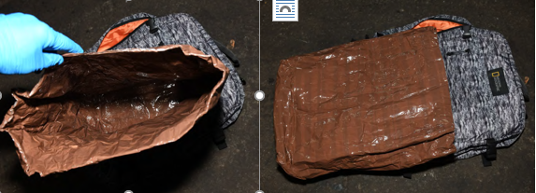
Romanian OCG involved in the organised theft of alcohol from shops Tipperary and Nationwide March 2023 to Feb 2024
Tipperary Gardaí are investigating a series of thefts from shops from March 2023 to Feb 2024 by Organised Romanian Nationals. This OCG were involved in excess of 85 thefts and property value of €50,000 stolen.
Suspects made up of mainly 3-4 males and 1 female using earpieces and foil lined backpacks
Suspects were stealing large quantities of Alcohol usually 8-10 bottles of spirits which can fit into the back pack
Suspects target different towns on the same date all over the country and Northern Ireland
Suspects tended to target towns with no security and enter at evening time when staff levels are lower.
UPDATE: On the 20.02.24 following An Garda Síochana SIS alerts and warnings on vehicles, 2 of these suspects were stopped driving a silver BMW in Newry Co. Down and found in possession of a substantial amount of stolen property from TK Maxx. Suspects had been in Belfast and were returning to Dublin. Suspects arrested brought to court and are currently in custody.
A planned search of a house in Dublin on the 21.02.24 recovered another vehicle (Hyundai I30), €7,ooo in cash, stolen North Face Clothing and 2 foil lined bags. Investigation ongoing, suspects to be arrested

Slide 14
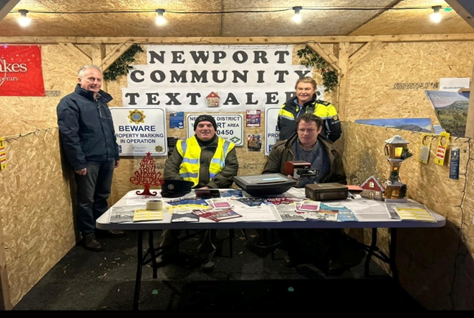
Community engagement
An indoor soccer tournament was held recently in Cholaiste Pobail, Roscrea which was organised by Gardaí in Nenagh. Various different nationalities took part.
Clonmel Community Policing Unit and Probationer Gardaí attended the Clonmel & District Wheelchair Society’s annual Christmas Party.
Newport Gardai recently assisted members of Newport Community Alert at their local Christmas markets. Crime prevention advice and property marking was carried out.

Slide 15
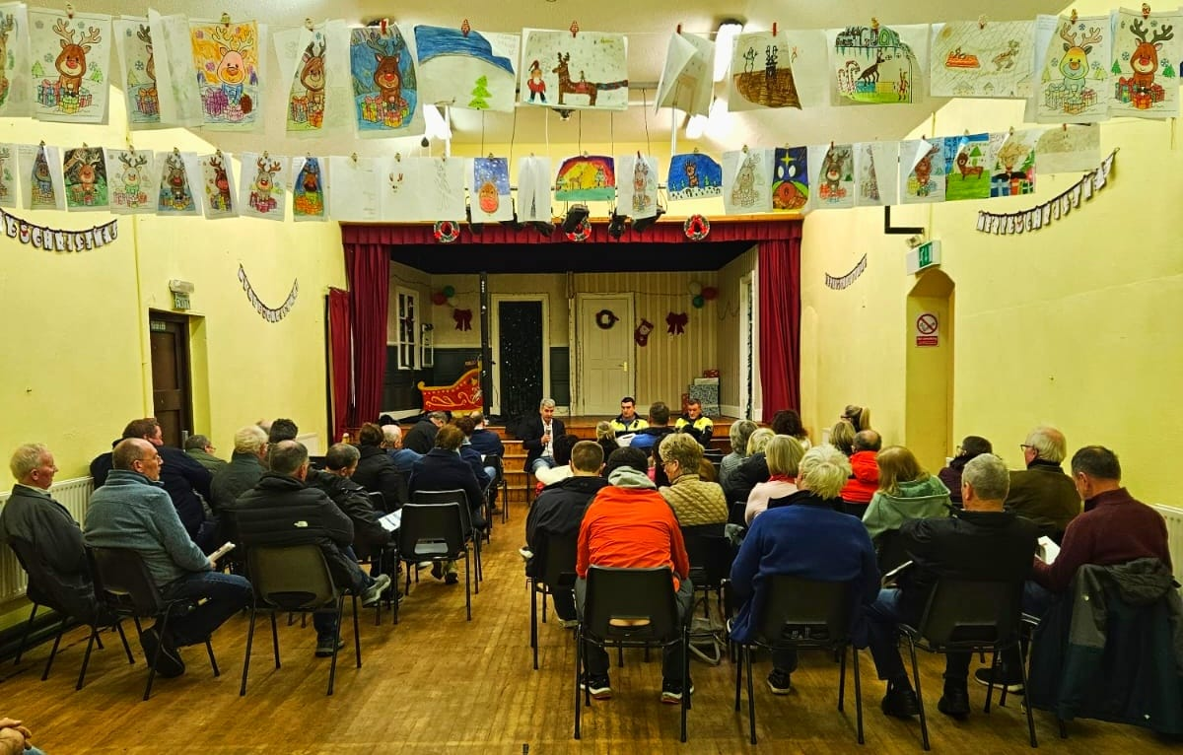
Community Engagement
Christmas and New Year Road Safety Enforcement Operation began November 30th and continued right up to 4th January 2024. This operation focused on the dangers of driving under the influence of an intoxicant, driving without a seatbelt, speeding or using a mobile phone while driving.
Gardaí in Nenagh hosted a Community Engagement and Property Marking Day across the Nenagh CE Area where they marked trailers, power tools, bicycles and a large amount of other valuable property.
Garda Garret Ryan and Garda Michael Hennessy of Borrisokane Garda Station recently gave a talk in the parish hall in Rathcabbin. The theme of the talk was one of Crime Prevention and it was well attended by the local community.

Slide 16
Divisional Community engagement coordinator
Dedicated person to deal with queries on behalf of Chief Superintendent Magner
Contact Details
Ms Breda Breen, Ennis Divisional Office
065 6848124
085 8547548
CT.CommunityLiaison@garda.ie

Slide 17
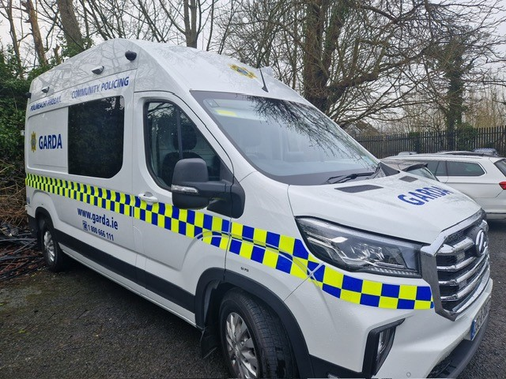
New Community policing van Clare/Tipperary Division
Vehicle allocated to the Division at the end of January
Can be used as a mobile Garda station
Will be allocated on a rotational basis around each Community Engagement Area in the Division
Vehicle fully equipped with Garda ICT requirements

