Slide 1

Joint Policing Committee – Tipperary Division
7th December 2023
Chief Superintendent Colm O’Sullivan

Slide 2
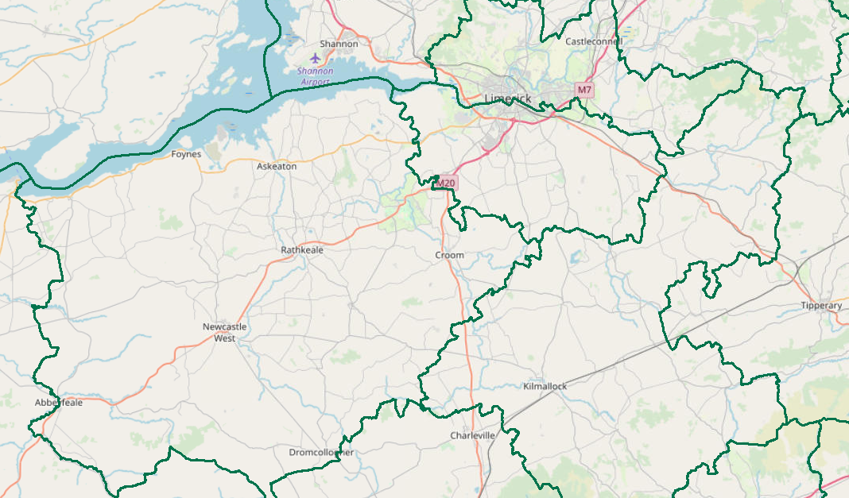
JPC Objectives
  Provide a brief statistical overview of current position as of 01/12/2023:
    Domestic Abuse Incidents
    Property Crime at a Divisional Level (broken down by District)
      Additional attention afforded to Burglary
    Crime Against the Person at a Divisional Level (broken down by District)
      Additional attention afforded to Assault.
    Proactive Policing Measure
      Includes Possession of Drugs, Sale of Drugs, and Offensive Weapons
    Traffic
      Fatalities/Serious Injuries figures YTD
      Drink and Drug Driving Offences
      LifeSaver Offences
  All information is based upon operational data from the PULSE System as was available on the 01/12/2023 and is liable to change. Crime Counting rules are applied, unless otherwise stated. Incident counts are based on date reported.

Slide 3
Domestic Abuse Incidents
includes
Breach of Barring Order
Breach of Protection Order
Breach of Safety Order
Domestic Dispute – No Offence Identified
Any incident with Domestic M.O.
YTD (1st Jan – 3rd Dec 2023)
the Division is
+7%
Based upon operational data from the PULSE System as was available on the 04/12/2023 and is liable to change. Incident counts are based on date reported.

Slide 4
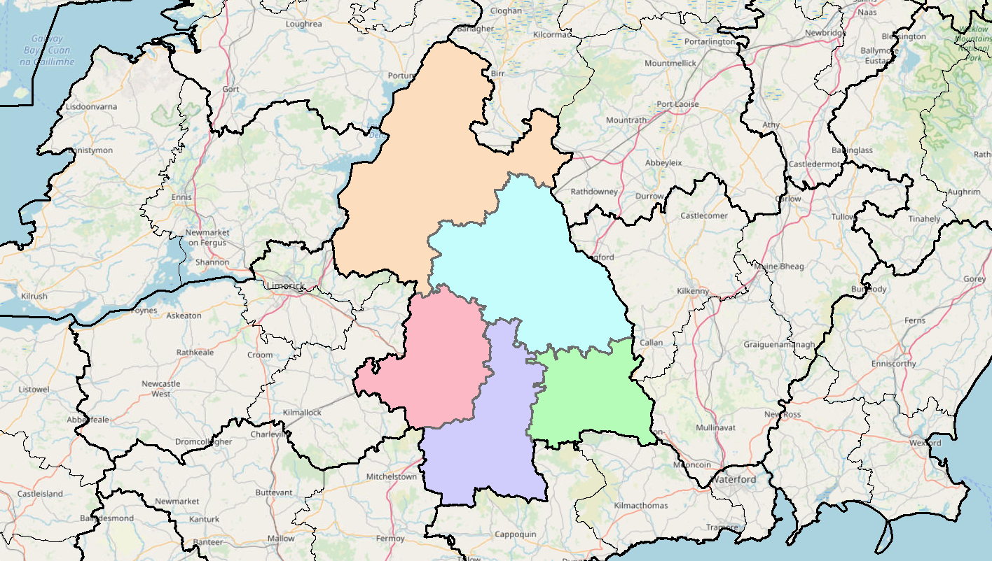
Property Crime includes:
All Robbery
All Burglary
And various Theft Offences
YTD the Division is +16%
(1,434 to 1,669)
+24%
(298 to 370)
-8%
(325 to 299)
+13%
(191 to 216)
+19%
(461 to 550)
+47%
(159 to 234)
Detections are +17% YTD (611 to 716)

Slide 5
Non Aggravated Burglary
YTD the Division is +5% YTD
(237 to 250 )
+14%
(43 to 49)
Residential Burglary is +5% YTD
Non Residential Burglary is +13% YTD
-24%
(58 to 44)
+15%
(46 to 53)
-19%
(69 to 56)
+129%
(21 to 48)
Detections are +7% YTD (75 to 80)

Slide 6
Crimes Against the Person includes
Murder
Murder Threat
All Assaults
Harassment
Child Abandonment
Neglect or Abuse.
YTD the Division is -4%
(638 to 612)
+1%
(135 to 136)
+3%
(142 to 146)
-4%
(55 to 53)
-3%
(209 to 202)
-23%
(97 to 75)
Detections are +22%YTD (311 to 380)

Slide 7
Assaults includes:
Assaults Causing Harm
Minor Assaults
YTD the Division is +1%
(460 to 466)
+10%
(100 to 110)
Assaults Causing Harm: -21% YTD (179 to 141)
Minor Assaults : +16% YTD (281 to 325)
+21%
(97 to 117)
0%
(43 to 43)
-3%
(148 to 144)
-28%
(72 to 52)
Detections are +17% YTD (237 to 278)

Slide 8
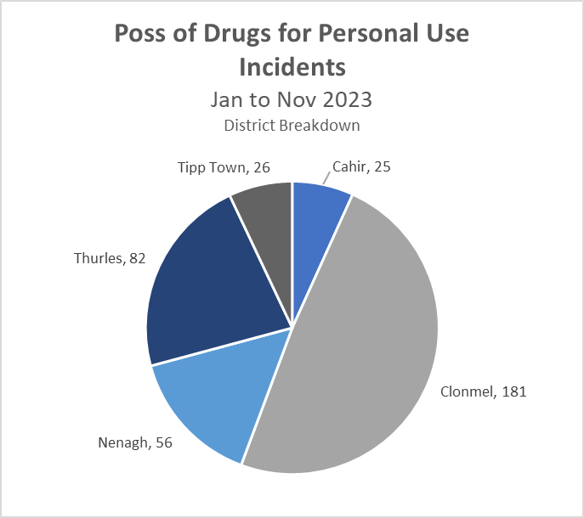
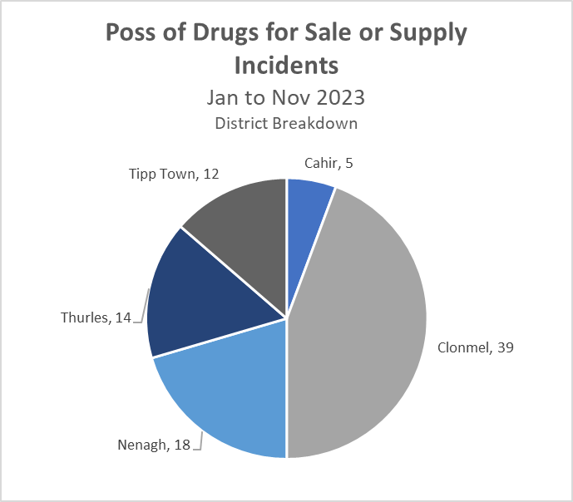
Proactive Policing Measures
Possession of Drugs for Personal Use
Up 6% YTD
(350 to 370)
Possession of Drugs for Sale/Supply
Down 15% YTD
(103 to 88)
Overall Searches within the Division are down 14%
Possession of Firearms/Offensive Weapons
+13% YTD
(61 to 69)
*Crime Counting Rules not applied

Slide 9



Traffic (YTD 2022 vs. 2023)
Fatal Collisions are up +57%
Serious Injury Collisions are 0% change (44 to 44)
There have been 2,593 MIT Checkpoints conducted in the Division – (down 24% from 3,422 YTD last year)
This has resulted in 242 Driving While Intoxicated Offences (down 7% from 260 YTD last year)
This figure includes 43 Drug Driving Offences (up 10% from 39 YTD last year)
Our most recent data regarding LifeSaver Offences shows the following Jan to Nov Trends
Mobile Phone
+4%
(575 to 596)
Seatbelt
-4%
(273 to 262)
Speed (Intercept & Non-Intercept)
+37%
(12,182 to 16,696)
Based upon operational data from the PULSE System as was available on the 01/12/2023 and is liable to change. Incident counts are based on date reported.

