Slide 1

Joint Policing Committee –
County Tipperary
15th September 2023
Chief Superintendent Colm O’Sullivan

Slide 2
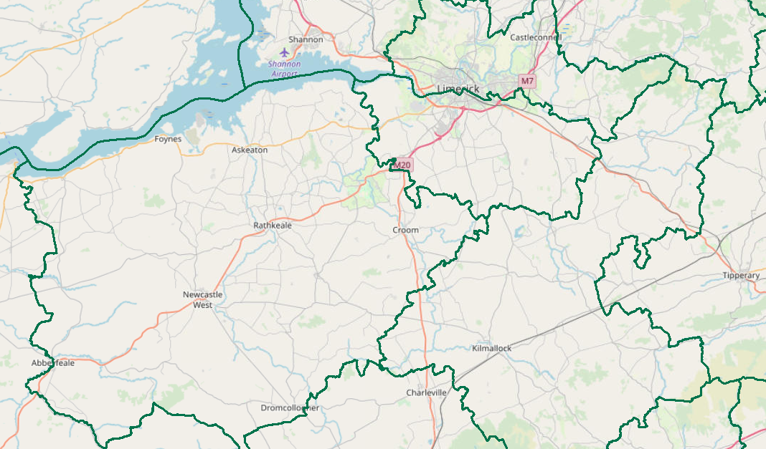
JPC Objectives:
Provide a brief statistical overview of current position as of 01/09/2023:
Property Crime at a Divisional Level (broken down by District)
    Additional attention afforded to Burglary
Crime Against the Person at a Divisional Level (broken down by District)
    Additional attention afforded to Assault
Proactive Policing Measure
    Includes Possession of Drugs, Sale of Drugs, Firearms and Offensive Weapons
Traffic
    Fatalities/Serious Injuries figures YTD (1st Jan – 31st Aug 2023)
    Drink Driving and Drug Offences YTD (1st Jan – 31st Aug 2023)
    LifeSaver Offences YTD (1st Jan – 31st July 2023)
5. Domestic Abuse Incidents YTD (1st Jan – 3rd Sept 2023)
This document is suitable for Public Dissemination
All information is based upon operational data from the PULSE System as was available on the 01/09/2023, unless otherwise stated, and is liable to change. Crime Counting rules are applied, unless otherwise stated. Incident counts are based on date reported.

Slide 3
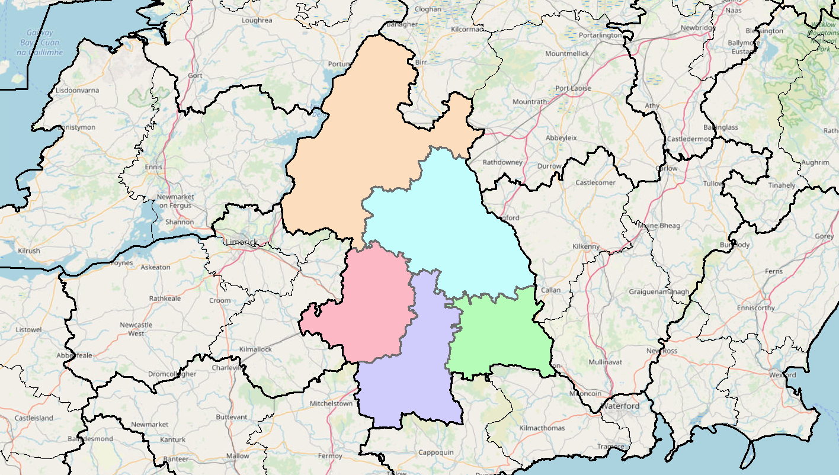
Property Crime includes:
All Robbery
All Burglary
And various Theft Offences
YTD the Division is +7%
(1,037 to 1,111) +74
Nenagh +29%
(192 to 248)
+56
Thurles
-26%
(258 to 190)
-68
Tipperary+7%
(128 to 137)
+9
Clonmel
+14%
(342 to 390)
+48
Cahir
+25%
(117 to 146)
+39
Detections are +14% YTD (436 to 495)

Slide 4
Non Aggravated Burglary
YTD the Division is -13% YTD
(187 to 162 ) -25
Nenagh
-14%
(36 to 31)
-5
Residential Burglary is +7% YTD
Non Residential Burglary is +17% YTD
Thurles
-46%
(50 to 27)
-23
Tipperary
+15%
(33 to 38)
+5
Clonmel
-34%
(53 to 35)
-18
Cahir
+107%
(15 to 31)
+16
Detections are +9% YTD (53 to 58)

Slide 5
Crimes Against the Person includes
Murder
Murder Threat
All Assaults
Harassment
Child Abandonment
Neglect or Abuse.
YTD the Division is -3%
(460 to 446) -14
Nenagh
-11%
(101 to 90)
-11
Thurles
+19%
(101 to 120)
+19
Tipperary
-2%
(41 to 40)
-1
Clonmel
-4%
(144 to 138)
-6
Cahir
-21%
(73 to 58)
-15
Detections are +42%YTD (202 to 286)

Slide 6
Assaults includes:
Assaults Causing Harm
Minor Assaults
YTD the Division is +3%
(337 to 348) +11
Nenagh
+1%
(76 to 77)
+1
Assault Causing Harm: -30% YTD (130 to 91)-39
Minor Assaults : +24% YTD (207 to 257) +50
Thurles
+37%
(71 to 97)
+28
Nenagh
-3%
(34 to 33)
-1
Clonmel
-5%
(103 to 98)
-5
Cahir
-19%
(53 to 43) -10
Detections are +38% YTD (151 to 208)

Slide 7
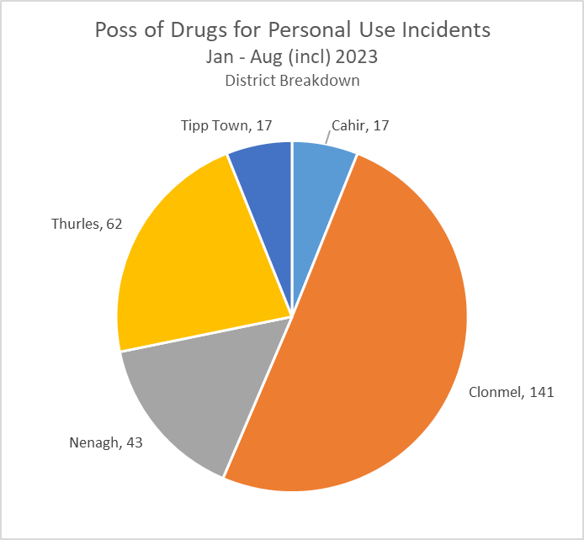
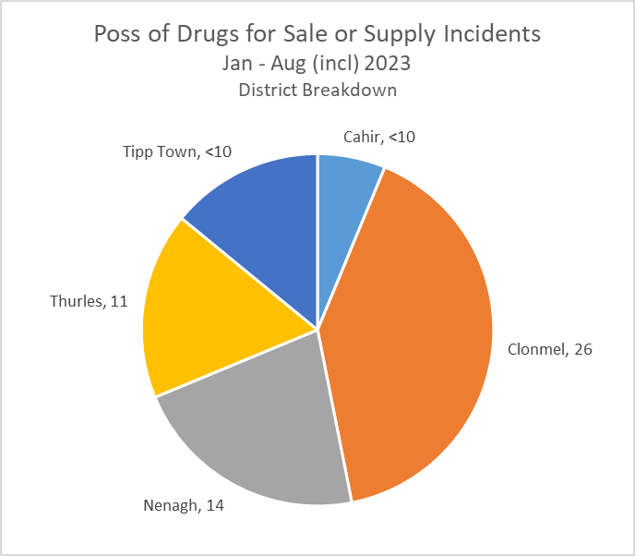
Proactive Policing Measures
Possession of Drugs for Personal Use
Up 17% YTD
(240 to 280) +40
Possession of Drugs for Sale/Supply
Down 19% YTD
(79 to 64) -15
Overall Searches within the Division are down 6%
Possession of Firearms/Offensive Weapons
+33% YTD
(43 to 57) +14
*Crime Counting Rules not applied

Slide 8



Traffic (YTD 2022 vs. 2023)
Fatal Collisions are up +200%
Serious Injury Collisions are down 14% (35 to 30)
There have been 1,875 MIT Checkpoints conducted in the Division – (down 27% from 2,580 YTD last year)
This has resulted in 183 Driving While Intoxicated Offences (up 2% from 180 YTD last year)
This figure includes 45 Drug Driving Offences
Our most recent data regarding LifeSaver Offences shows the following Jan to July Trends
-8%
(415 to 381)
-34
+22%
(166 to 202)
+36
-9%
(2,440 to 2,225)
-215
Based upon operational data from the PULSE System as was available on the 01/09/2023 and is liable to change. Incident counts are based on date reported.

Slide 9
Domestic Abuse Incidents
includes
Breach of Barring Order
Breach of Protection Order
Breach of Safety Order
Domestic Dispute – No Offence Identified
Any incident with Domestic M.O.
YTD (1st Jan – 3rd Sept 2023)
the Division is
+9%
Based upon operational data from the PULSE System as was available on the 04/09/2023 and is liable to change. Incident counts are based on date reported.

