Slide 1

Joint Policing Committee – Tipperary Division
16th December 2022
Chief Superintendent Colm O’Sullivan

Slide 2
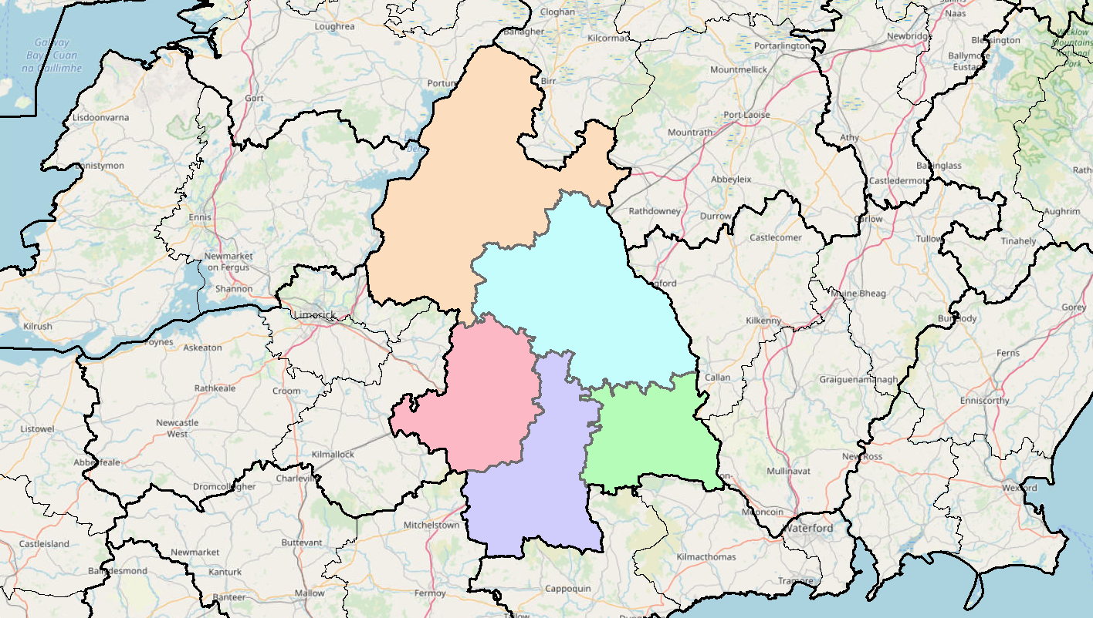
JPC Objectives:
Provide a brief statistical overview of current position as of 01/12/2022:
Domestic Abuse Incidents
Property Crime at a Divisional Level (broken down by District)
    Additional attention afforded to Burglary
Crime Against the Person at a Divisional Level (broken down by District)
    Additional attention afforded to Assault
Proactive Policing Measures
    Includes Possession of Drugs, Sale of Drugs, Offensive Weapons
Traffic
    Fatalities/Serious Injuries figures YTD
    Drink Driving and Drug Offences
    LifeSaver Offences
All information is based upon operational data from the PULSE System as was available on the 01/12/2022, unless otherwise stated, and is liable to change. Crime Counting rules are applied, unless otherwise stated. Incident counts are based on date reported.

Slide 3
Domestic Abuse Incidents
Year to date (30-Nov) :
Division is
+13%
Includes:
Breach of Interim Barring Order
Breach of Protection Order
Breach of Barring Order
Breach of Safety Order
Domestic – No Offence Identified
Breach of Emergency Barring Order; and
Any incident with Domestic M.O.
All information is based upon operational data from the PULSE System as was available on the 05/12/2022 and is liable to change. Incident counts are based on date reported.

Slide 4
Property Crime includes:
All Robbery
All Burglary
Various Theft Offences
YTD the Division is +35%
(1,079 to 1,457)
Nenagh
+36%
(215 to 292)
Thurles
+46%
(226 to 331)
Tipp Town +63%
(119 to 194)
Clonmel
+29%
(371 to 480)
Cahir
+8%
(148 to 160)
Detections are +9% YTD (572 to 623)

Slide 5
Non-Aggravated Burglary
YTD the Division is +11%
(212 to 236)
Nenagh
-25%
(56 to 42)
Residential Burglary is +3% YTD
Non-Residential Burglary is +37% YTD
Thurles
+67%
(36 to 60)
Tipp Town +80%
(25 to 45)
Clonmel
-12%
(77 to 68)
Cahir
+17%
(18 to 21)
Detections are -9% YTD (82 to 75)

Slide 6
Crimes Against the Person includes:
Murder
Murder Threat
All Assaults
Harassment
Child Abandonment
Neglect or Abuse
YTD the Division is +20%
(522 to 624)
Nenagh
+28%
(101 to 129)
Thurles
+30%
(110 to 143)
Tipp Town -9%
(55 to 50)
Clonmel
+7%
(199 to 212)
Cahir
+58%
(57 to 90)
Detections are -5%YTD (330 to 314)

Slide 7
Assaults includes:
Assaults Causing Harm
Minor Assaults
YTD the Division is +18%
(381 to 450)
Nenagh
+39%
(70 to 97)
Assaults Causing Harm: +43% YTD (116 to 166)
Minor Assaults : +7% YTD (265 to 284)
Thurles
+32%
(75 to 99)
Tipp Town -22%
(50 to 39)
Clonmel
+1%
(144 to 145)
Cahir
+67%
(42 to 70)
Detections are -2% YTD (239 to 235)

Slide 8
Proactive Policing Measures
Overall Searches within the Division are down 33% YTD
Possession of Offensive Weapons
Down 19% YTD
(70 to 57)
Crime Counting Rules not applied
Possession of Drugs for Personal Use
Down 35% YTD
(540 to 349)
Possession of Drugs for Sale/Supply
Down 14% YTD
(122 to 105)

Slide 9



Traffic
Fatal Collisions There were 8 Fatal Collisions compared with 8 for the same period last year
Serious Injury Collisions are up 18% (33 to 39)
There have been 3,421 MIT Checkpoints conducted in the Division – (up 38% from 2,478 YTD last year)
This has resulted in 262 Driving While Intoxicated Offences (up 3% from 255 YTD last year)
This figure includes 58 Drug Driving Offences (down 19% from 72 YTD last year)
Our most recent data regarding LifeSaver Offences shows the following Jan to Oct Trends
-34%
(818 to 540)
+28%
(203 to 260)
-20%
(4,156 to 3,324)
Notes:
LifeSaver Offences:
Mobile Phone
Seatbelt
Speeding - Intercept

